Slide 1
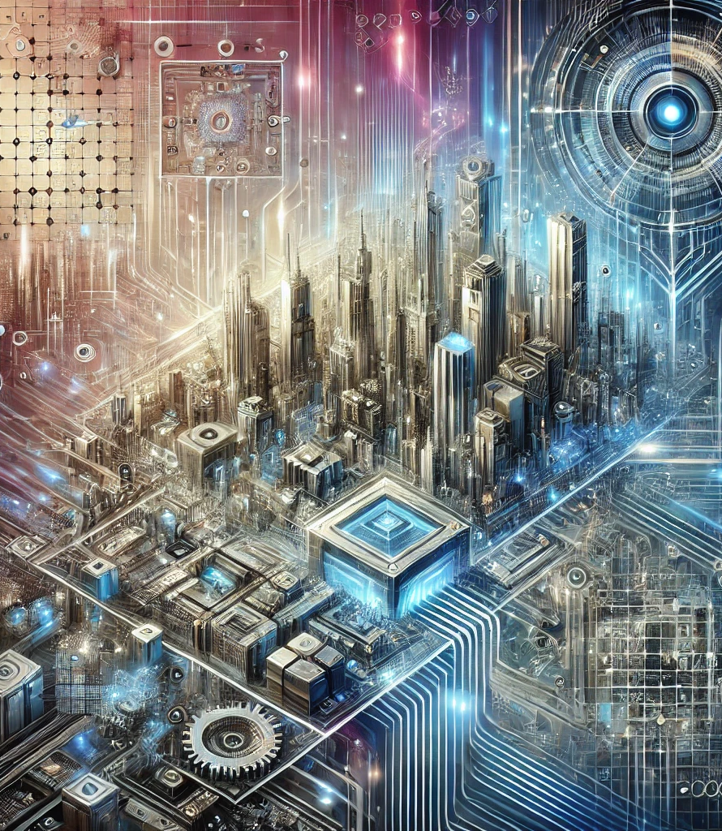
Historical Timeline of Computer Vision
2020-2024
A01_Group 1_Great Achievers_Marvin Azuogu-Brandie Griffin-Martin Demel-Jordan Allen-Sydney Chilson_ITAI1378
Department of Science, Technology, Engineering & Math
Houston Community College
AAA – ARTIFICIAL INTELLIGENCE (A.I.)
26th of August

Slide 2



Historical Time of Computer Vision in early 2020s
2022
BYOL (Bootstrap Your Own Lantern) Self Supervised learning model became more sophisticated and outperformed traditional models in several benchmarks. (ArXiv)
More Countries adopted AI regulations with focus on Facial recognition. (Harvard Business review and World Economic Forum)
Yann LeCun research of Self supervised learning influenced how Tech. companies advanced towards AI Development. (Meta)
Augmented Reality mainstream adoption in Education and Retail by providing interactive environments. (ScienceDirect)
Vision Transformers (ViT) introduced by Google. (arXiv)
NVIDIA introduced StyleGAN3 that further refined quality of Image Generation. (NVIDIA)
Geoffrey Hinton continuous Capsule research and its possible image recognition by preserving spatial hierarchies.(arXiv)
Waymo expanded its fleet in Phoenix & Arizona. (Waymo report)
StyleGAN3 used in Commercial production to create realistic digital doubles. (MarkTechPost)
2020
2024
DALL-E Introduction by OpenAI which uses the diffusion models. (OpenAI Blog)
The AI Act proposed by the European Union that encouraged towards ethical practice. (EU)
Yann LeCun – Shaping research agenda in AI Community by self super-vised learning and highlighting energy-based models. (Meta & ArXiv)
Fei-Fei Li – Shaping AI Policies in USA specifically in Ethics for Healthcare and Law enforcement. (ApNews)
AI Healthcare diagnostics tools were expanded in Hospitals to early detect Cardiovascular and cancer related diseases. (Nature Medicine)
Vision Transformers updated to process more sophisticated tasks like 3D Scene reconstruction and Object tracking in Videos. (Medium)
Fei-Fei Li continued to advocate for ethical AI with focus on sensitive data and human centered principles. (McKinsey)
Smart Cities improved planning and safety by adopting AI- powered technologies.
AI driven surveillance brought debates over privacy due to advanced capabilities. (Sifi)
Ampere Architecture released for GPUs.
Object Detection YOLOv4 developed. (ArXiv)
Fei-Fei Li accomplished early adoption of AI in Healthcare. (McKinsey & Nature)
Tesla FSD Full Self Driving launched. (Engadget)
Deep learning models applied for diabetic retinopathy detection. (Nature & Pubmed.)
2023
2021
Key Advancements Influential Figures Impactful Applications

Slide 3
Sources
NVIDIA Ampere GPU Architecture Overview - https://developer.nvidia.com/blog/nvidia-ampere-architecture-in-depth/
https://www.nvidia.com/content/PDF/nvidia-ampere-ga-102-gpu-architecture-whitepaper-v2.pdf
IEEE Spectrum on Real-Time Video Processing - https://ieeexplore.ieee.org/document/9051222
The Guardian Fei-Fei Li – https://www.theguardian.com/technology/2023/nov/05/ai-pioneer-fei-fei-li-im-more-concerned-about-the-risks-that-are-here-and-now
YOLOv4 Development - https://arxiv.org/abs/2004.10934
Tesla FSD - https://www.engadget.com/tesla-full-self-driving-beta-october-20-171500591.html
Nature Medicine Article on AI in Healthcare – https://www.nature.com/articles/s41586-020-2669-y
Bedside Computer Vision - https://pubmed.ncbi.nlm.nih.gov/29617592/
Vision Transformer Research Paper on arXiv - https://arxiv.org/abs/2010.11929
https://medium.com/@maheshhkanagavell/cutting-edge-algorithms-revolutionizing-image-and-video-analysis-in-2025-14f68cfb17a2
StyleGAN3 https://www.marktechpost.com/2021/10/12/nvidia-ai-releases-stylegan3-alias-free-generative-adversarial-networks/
StyleGAN3 Research Paper on arXiv - https://arxiv.org/abs/2106.12423
EU - https://digital-strategy.ec.europa.eu/en/policies/european-approach-artificial-intelligence
Yann LeCun Self Supervised learning https://arxiv.org/abs/2304.09355
Smart Cities https://sifinetworks.com/corporate/trends-that-will-shape-smart-cities-in-2024/
Yann LeCun Self Supervised cookbook https://ai.meta.com/blog/self-supervised-learning-practical-guide/?utm_source=linkedin&utm_medium=organic_social&utm_campaign=blog&utm_content=link
DALL-E Introduction - https://openai.com/index/dall-e-introducing-outpainting/
Healthcare diagnostics tools used in Medicine https://www.ncbi.nlm.nih.gov/pmc/articles/PMC10590060/
Capsule Networks Paper by Geoffrey Hinton - https://arxiv.org/abs/1710.09829
Fei-Fei Li https://www.mckinsey.com/featured-insights/mckinsey-on-books/author-talks-dr-fei-fei-li-sees-worlds-of-possibilities-in-a-multidisciplinary-approach-to-ai
Waymo's Blog on Autonomous Driving - https://waymo.com/blog/2021/12/accelerating-mission-velocity/
Nature on AI and Ethics: https://www.nature.com/articles/s42256-022-00598-x
Augmented Reality adoption https://www.sciencedirect.com/science/article/pii/S2590291123001377
Nature Medicine Healthcare diagnostics - BYOL Research Paper - https://arxiv.org/abs/2006.07733
Transactions on Pattern Analysis and Machine Intelligence - https://en.wikipedia.org/wiki/IEEE_Transactions_on_Pattern_Analysis_and_Machine_Intelligence
Fei-Fei Li Ethical AI focus – AI https://apnews.com/article/ai-pioneer-feifei-li-stanford-computer-vision-imagenet-702717c10defd89feabf01e6c1566a4b
OpenAI supporting materials - https://chatgpt.com/
OpenAI Prompt: Give me the short bullet point list of most influential figures, key advancements and impactful application in AI - Computer vision between 2020 and 2024.

Slide 4
Thank you.

